Slide 1
Welcome
To
Project-1_Next-Hikes.ppt
Name : Mohd Zeeshan
25-Jan-2024

Slide 2
Abstract
“In this project, we read Dataset_1 and found out about its types. After that we found out about the shape of the given dataset_1. When we found out about the types of dataset_1, we came to know that in the column dteday object, we have to convert it into integer.
After then that read the dataset_2 and find out about its types and shape. And found out about the columns of dataset_2. Then dataset_2 instant values turn up.
Then after that dataset_1 and dataset_2 were merged. And found out about the columns and shape of the merged data, and extract the unique values of the merged data. All the useless columns were thrown out integer merged data.
And then, we check the summary of merged dataset and in the last we were looking on central tendency on the merged dataset and find the mean, median, mode or std.
After that we read dataset_3 and found out about its types and shapes. After that the merged data and dataset_3 were concatenated, and then moved on visualization and get the outliers of final dataset, and make the boxplot of final dataset
Finally we checked the skewness and correlation of final dataset. We analyzed the data or after that convert the final data into excel file.”

Slide 3
Content
Introduction
Objectives
Methods
Results
Conclusion

Slide 4
INTRODUCTION
In this project we ride of bike, we got data to use data wrangling. There are many ambiguities in this data. In this data there are many columns (date of ride, season, holiday, working day, weather, windspeed, humidity etc).
To read the data, we imported two important libraries pandas and numpy. The first task in this project was data acquisition and data wrangling. On which we applied all the methods or data wrangling.

Slide 5
OBJECTIVES
Data Acquisition :- Data acquisition involves organizing information in a clear and visually engaging manner. Below is an outline that you can use to structure your presentation. Make sure to customize it according to your specific needs and audience.
Step 1: Introduction
Brief overview of data acquisition.
Importance of using Python for data acquisition.
Outline of the presentation.
Step 2: Why Python for Data Acquisition?
Python's popularity in data science and engineering
Rich ecosystem: libraries and frameworks (NumPy, Pandas, Matplotlib)
Community support and documentation.
Data Cleaning:-
The data will need to be cleaned and removed missing values for better prediction.

Slide 6
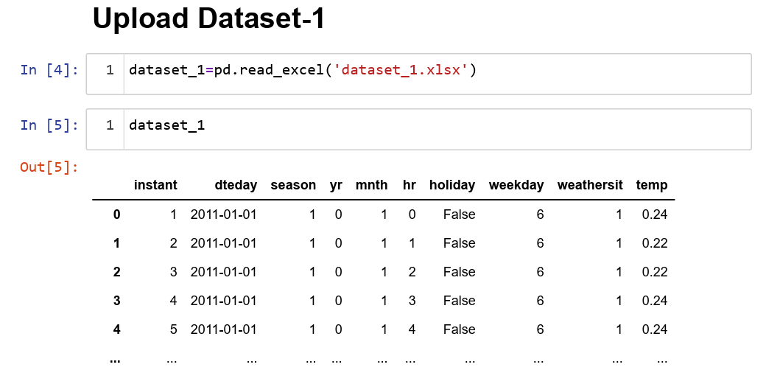
METHODS
Import Data and Conversion:
We have dataset_1 and dataset_2 using this data set we have first imported this data set from external drive to jupyter notebook using pandas Dataframe coding.

Slide 7
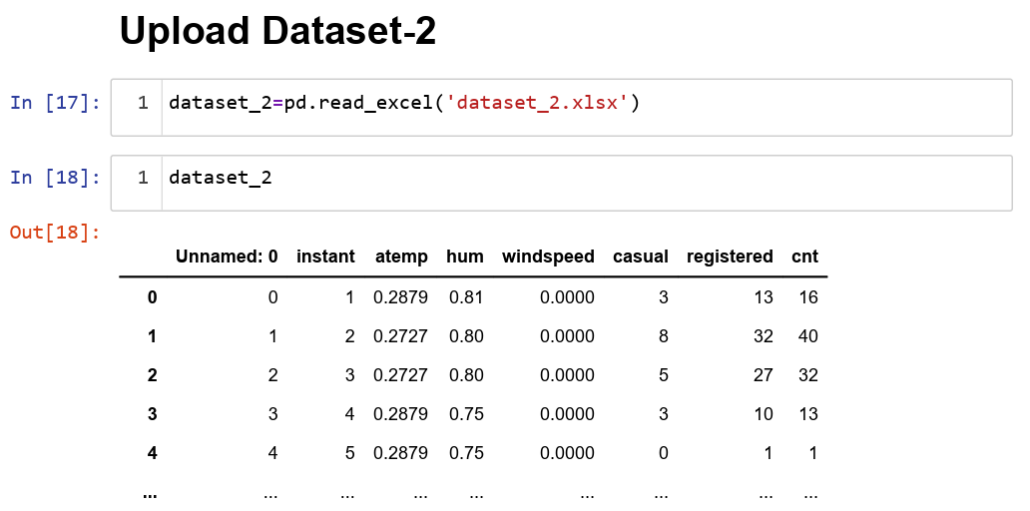
Then we find the unique values and data cleaning ,so that we can read easily whole dataset.

Slide 8
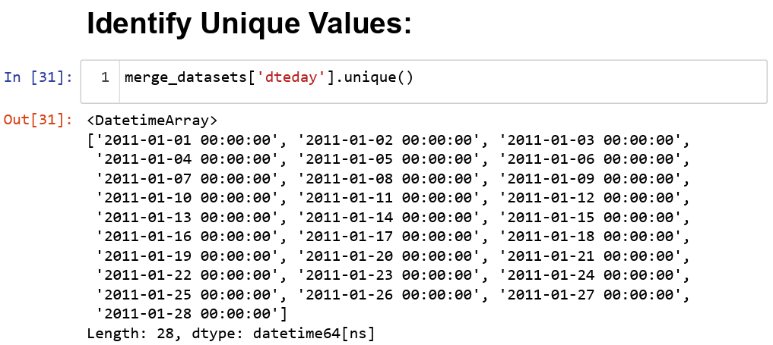

Slide 9
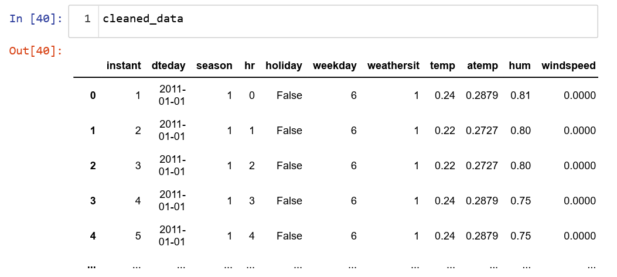
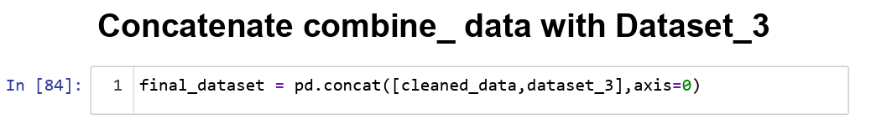
Concatenate combine datasets:

Slide 10
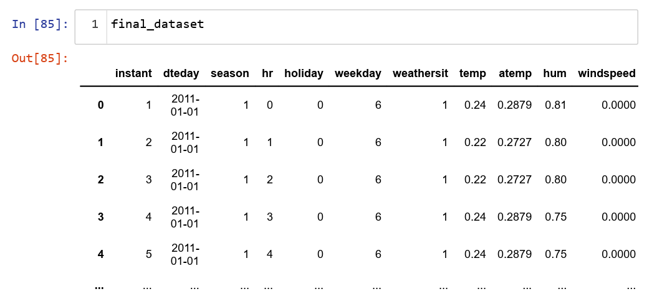
Showing the Boxplot of final dataset:-

Slide 11
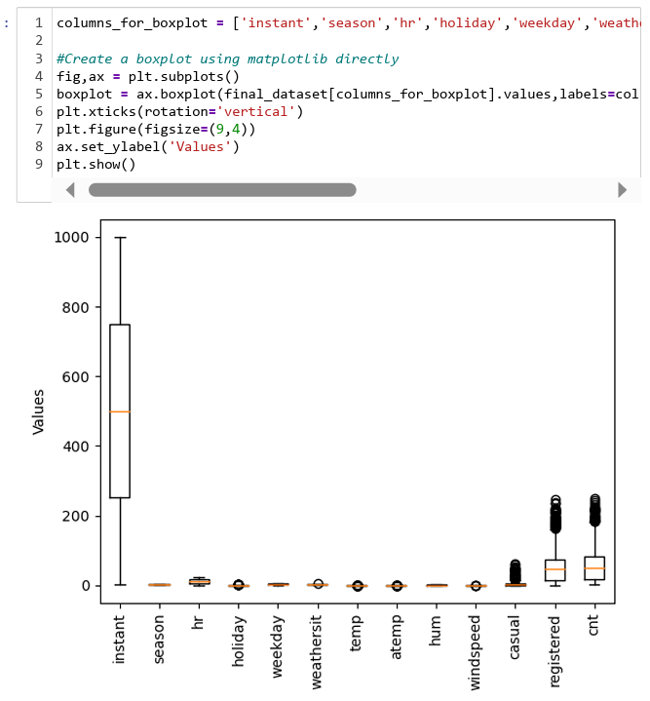

Slide 12
RESULTS
“After the data cleaning, we apply all the methods so we can easily read the data or can easily work on the data. Then we have got the result from the data and remove all the missing values and find also outliers in the data. And we our project convert into excel file.”

Slide 13
CONCLUSION
“The main object of this project is bike riding, while we are talking about the speed of the bike or the speed of the wind or the humidity. And then our investigation we will find out that is the project which has missing values or unwanted columns which we have removed. And now we can easily understanding about this project.”

Slide 14

THANK-YOU

